Slide 1

Ola Electric Service Crisis Analytics
Data-driven analysis of sales, complaints, warranty and service performance
Final Project Report | 2023–2024
SQL • Excel • Power BI • Statistical Analysis
Presented by: P. Geetha

Slide 2
1. Business Problem
Total Complaints
92K
Ola Electric experienced a major customer-service crisis during 2024.
•Service complaints increased sharply, creating significant pressure on service operations.
• The project examines whether sales trends moved alongside complaints, warranty claims and service jobs.
• The objective is to convert operational data into actionable management insights.
Focus Year of Service crisis Analysis
2024
Multi – Source
Sales + Service + Warranty + Customer Data
Objective: Identify the operational drivers of the service crisis and their impact on business performance.

Slide 3
2. Project Objectives
📈 Sales Analysis | 📍 Complaint Hotspots
🔧 Service & Warranty | 🔗 Relationship Analysis
📊 Statistical Analysis | 📊 Power BI Dashboard
To understand the Ola Electric service crisis using sales, complaint, warranty and service data; identify key operational issues, analyze relationships between KPIs, and apply statistical techniques to support data-driven management decisions.

Slide 4
3. Project Requirement Documents
Business Requirement Document
Defines the business problem, objectives, scope and expected outcomes.
Business Requirements Document.docx
Functional Requirement Document
Defines the functional requirements, KPIs and dashboard requirements.
Functional Requirements Document.docx

Slide 5
4. Data & Analytical Methodology
Data sources
Sales, complaints, warranty claims, job cards, service centers, vehicle/customer and supporting operational data
Data preparation
Cleaning dates, standardizing cities, handling missing values, and preparing analysis-ready tables
Tools
PostgreSQL / SQL • Excel • Power BI • Power Query
Methods
KPI Analysis • Heatmap • Correlation • Hypothesis Testing • Regression • Forecasting

Slide 6
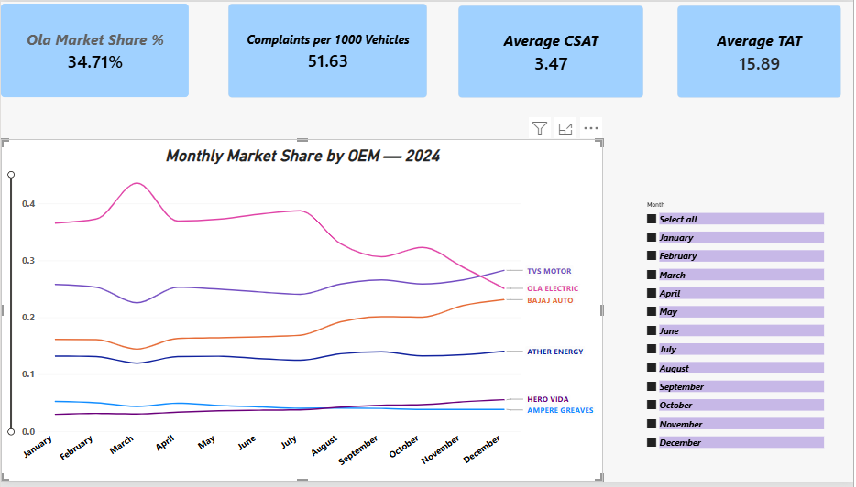
5. Crisis Overview - EDA

Slide 7
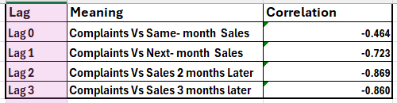
6. Lag Correlation Analysis – 2024
Key Insight:
Complaints show the strongest negative relationship with sales at a
2-month lag (r = -0.869), suggesting complaints may act as an early-warning indicator for future sales decline.

Slide 8
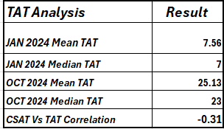
7. TAT Analysis
Mean TAT increased from 7.56 days in January to 25.13 days in October, while median TAT increased from 7 to 23 days, showing a substantial deterioration in service turnaround time.

Slide 9
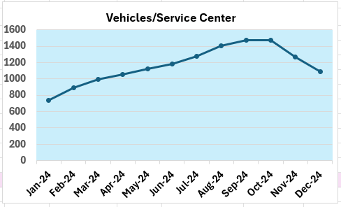
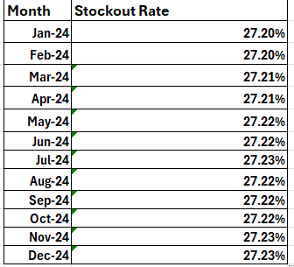
8. Vehicles per Active Service Centre — 2024
Stockout rate remained consistently around 27.2%, indicating a persistent parts-availability constraint.

Slide 10
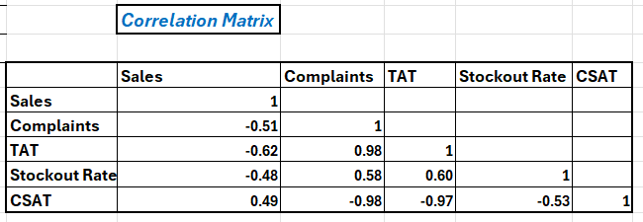
9. Monthly KPI Correlation Matrix — 2024
Higher complaints are strongly associated with longer TAT and lower CSAT, while longer TAT is also negatively associated with customer satisfaction.

Slide 11

10. Sentiment vs Sales

Slide 12
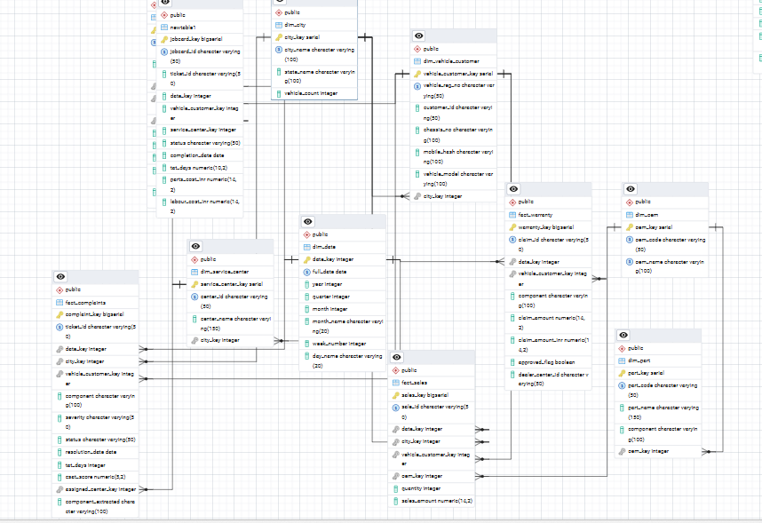
11. ERD – Ola Electric Service Analytics Database
Shows the relationships between sales, complaints, warranty, service jobs and supporting master data used for analysis.

Slide 13
12. Statistical Analysis
Sales Vs Complaint
Correlation
-0.464
Sales Vs Warranty Claims
Correlation
0.012
Sales Vs Service Jobs
Correlation
-0.464
R² - Sales Vs Complaints
0.215
Regression Slope
-0.083
Regression Intercept
9514.73

Slide 14
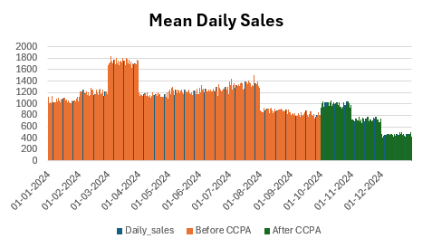
13. Hypothesis Testing — Sales Before vs After CCPA
3.84 × 10⁻³⁸
P - Value
0.05
Significance Level α
Reject H₀
Decision
The pre- and post-CCPA mean daily sales differed significantly (p < 0.05); therefore, H₀ was rejected.

Slide 15
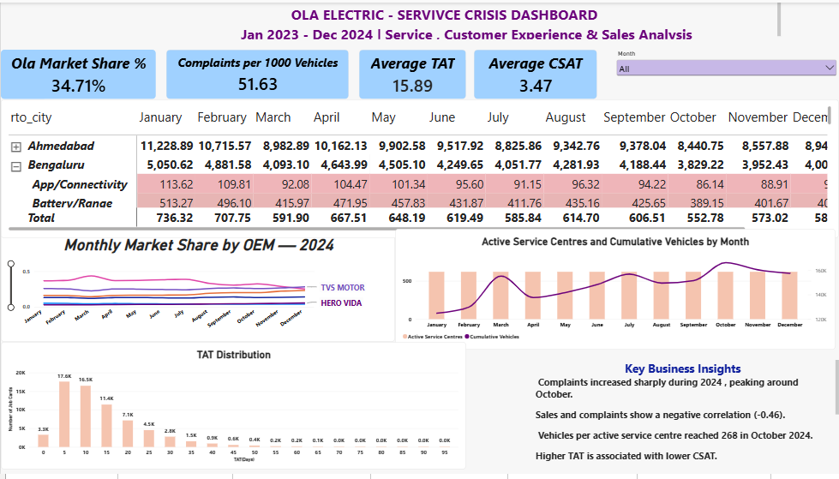
14. Power BI Dashboard

Slide 16
15. Regression Analysis — Sales vs Complaints
0.215
R² (21.5% of variation explained)
-0.083
Slope
9514.73
Intercept
Fitted relationship: Sales ≈ 9514.73 − 0.083 × Complaints
• The model explains approximately 21.5% of the variation in sales in the analyzed monthly data.
•The negative slope indicates that higher complaint levels are associated with lower fitted sales.

Slide 17
16. Forecast Validation — Registrations & Complaints
Registration Forecast
Complaint Forecast
Holdout period: Oct–Dec 2024
Forecast horizon: 3 months
Confidence interval: 95%
Seasonality: 12 months
MAPE: 7.48%
Holdout period: Oct–Dec 2024
Forecast horizon: 3 months
Confidence interval: 95%
Seasonality: 12 months
MAPE: 16.02%
Validation finding: The registration forecast produced a lower MAPE (7.48%) than the complaint forecast (16.02%) for the Oct–Dec 2024 holdout period.

Slide 18
17. Business Recommendations
Strengthen service capacity in high-complaint locations.
Monitor early-warning KPIs — complaints, TAT, service jobs and CSAT.
Track monthly trends to identify emerging problems early.
Identify recurring issues and address their root causes.
Use the Power BI dashboard for continuous management monitoring.

Slide 19
17. Conclusion:
Analysed sales, complaints, warranty and service data.
Identified important trends and complaint hotspots.
Found a statistically significant difference in sales between the analysed pre- and post-CCPA periods.
The Power BI dashboard helps monitor performance and identify service issues.
Overall, the project supports data-driven business decisions.

Slide 20
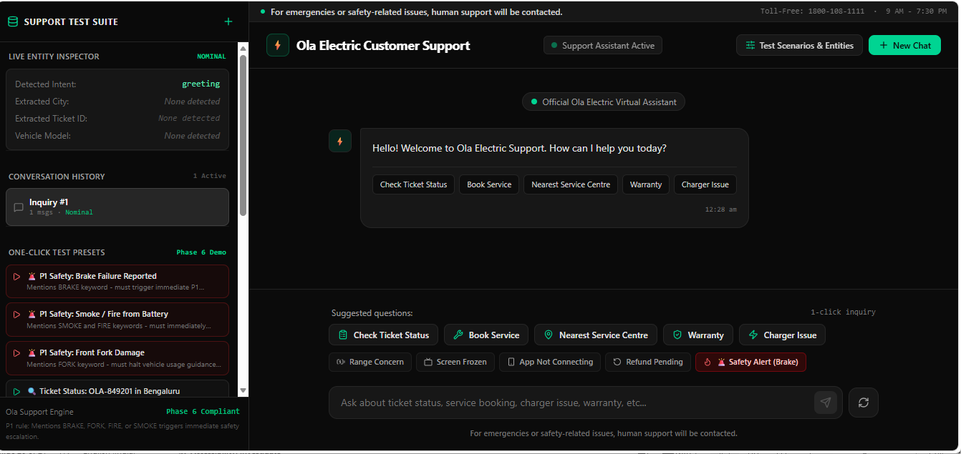
19. Customer Support Chatbot — Demo
Demonstrates customer support features including ticket status, service booking, nearest service centre, warranty and charger-related queries.
🔗 Open Customer Support Chatbot

Slide 21

Thank You

